Slide 1

OC – Project 8 CLOUD DEPLOYMENT MODEL
Fruits classification motor
Stephane Lanchec – April 2022

Slide 2
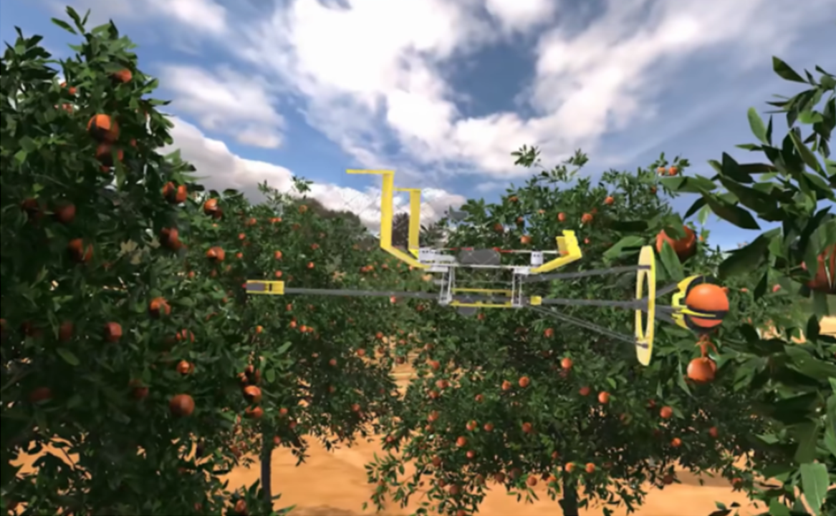
FRUITS! STARTUP PROBLEM OVERVIEW
Development of fruits picking robots to preserve biodiversity
Development of a first web app for fruits image classification
Enable users to get info from 1 picture of fruits
Raise public awareness on fruits biodiversity
MISSION
Develop a first chain of data processing in a Big Data environment
Preprocessing
Dimensionality reduction
CONSTRAINTS
Anticipate large data volume after app implementation
Use of Pyspark and cloud AWS ( EC2, S3, IAM)

Slide 3


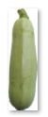


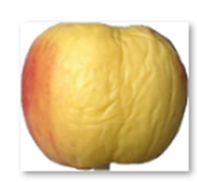
DATASET PROPERTIES
The total number of images: 90483.
Training set size: 67692 images (one fruit or vegetable per image).
Test set size: 22688 images (one fruit or vegetable per image).
The number of classes: 131 (fruits and vegetables).
Image size: 100x100 pixels.
Rotated fruits on 3 axis

Slide 4








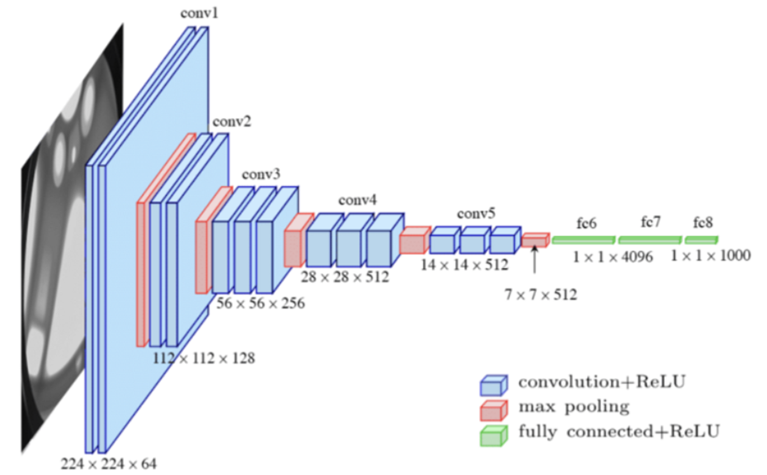
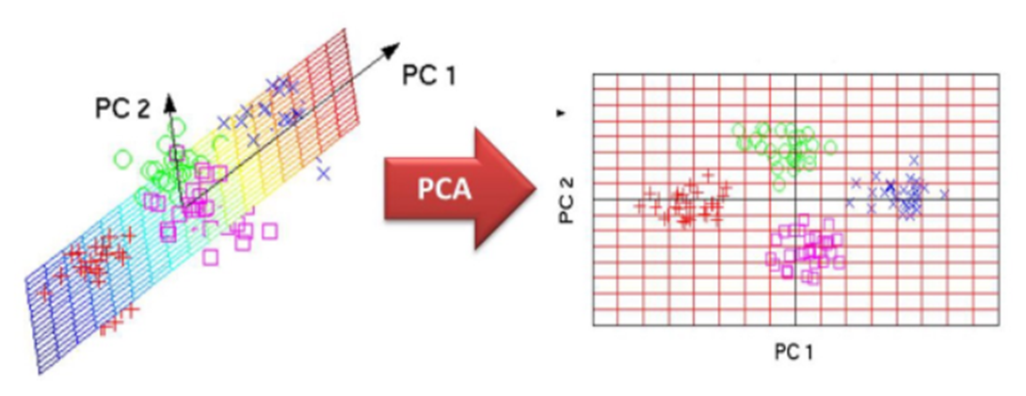
Process Workflow
Big Data Environment
Images preprocessing
Features extraction
Dimensionality reduction

Slide 5
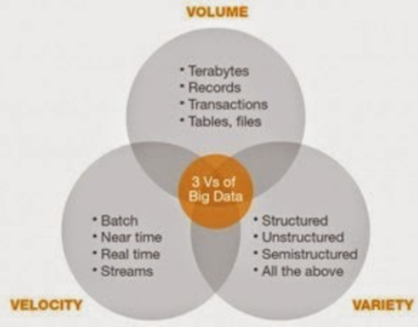
BIG DATA
Big data is a combination of structured, semistructured and unstructured data that can be mined for information and used in machine learning projects, predictive modeling and other advanced analytics applications.
The volume of data that companies manage skyrocketed around 2012. Volume doubles about every 40 months.
Information needs to flow quickly – as close to real-time as possible.
Data comes from many different sources:
from in-house devices to smartphone GPS technology or what people are saying on social networks.

Slide 6

Amazon Web Services is the leader in the industry
40% market share of the cloud service market
AWS cloud management system now has over a million customers and generates $10 billion in annual revenue.
The platform is trusted by companies like Kellogs, Samsung, Unilever, Nokia, Netflix, Adobe,
and most of the multinational giants.

Slide 7
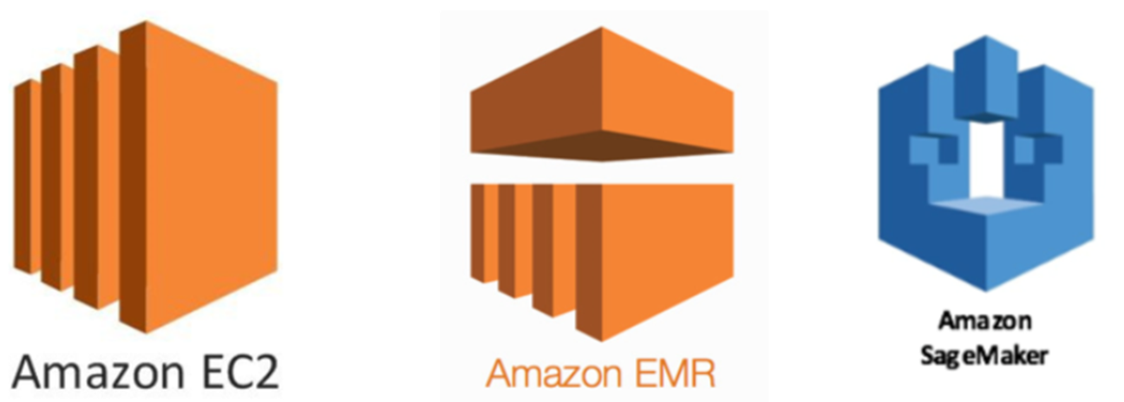
ML Models Deployment
Overview of three of the most popular tools to deploy machine learning models:
EC2 instances, EMR clusters, and SageMaker Notebooks.
Tool | Pros | Cons
EC2 | Baseline | Baseline
EMR | Cheap, autoscaling | Cumbersome
Sagemaker | Easy, powerful | Expensive
Amazon SageMaker is a fully-managed platform that enables developers and data scientists to quickly and easily build, train, and deploy machine learning models.
Virtual compute machines (instances) you can spin up for processing.
Amazon EMR is a managed cluster platform (using AWS EC2 instances) that simplifies running big data frameworks on AWS to process vast amounts of data.

Slide 8
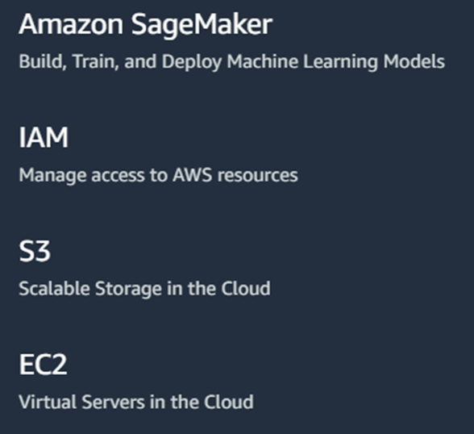
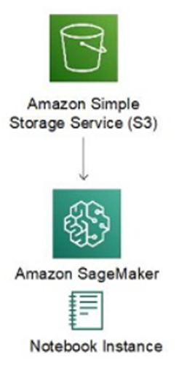
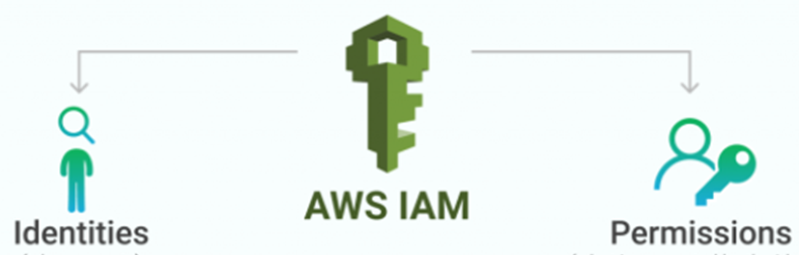



Big Data Architecture
Input files
2
3
Loading
Output files
1
Writing results
4
Cloud plateform
Account Login
User
Notebook instance creation

Slide 9

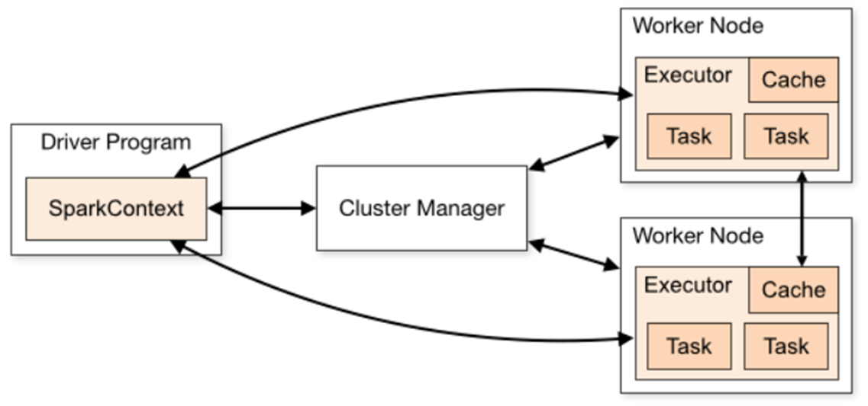
Data Processing Framework
Apache Spark is a fast and general engine for large-scale data processing.
Fast processing: Can quickly perform processing tasks on very large data sets & distribute data processing tasks across multiple computers
In-memory computing: Runs on memory (RAM), processing much faster than on disk drives.
Flexibility: Supports applications in Java, Scala, R, or Python
Real time processing: Not only stored data, able to produce instant outcomes
Driver asks for resources to the cluster manager to launch executors
Executor are worker nodes' processes in charge of running individual tasks in a given Spark job & send the results to the driver.
Converts the user program into tasks & schedules the tasks on the executors
Cluster manager launches executors.

Slide 10
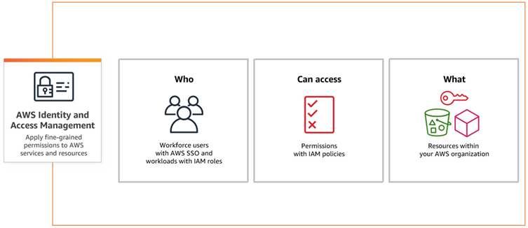
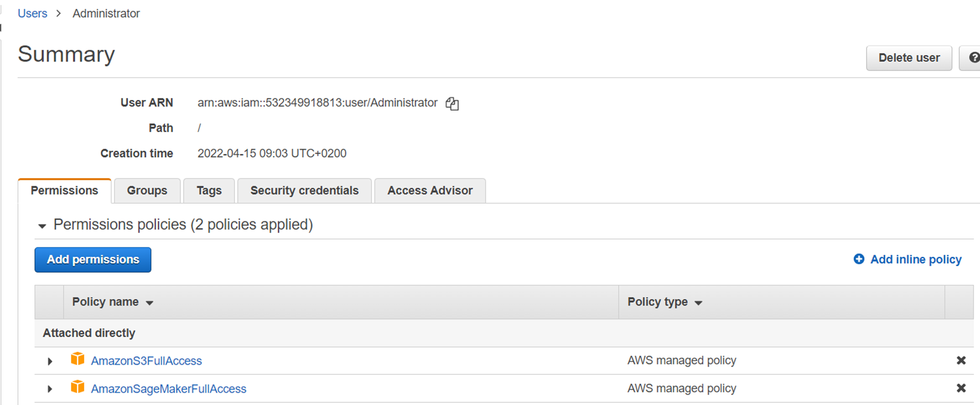
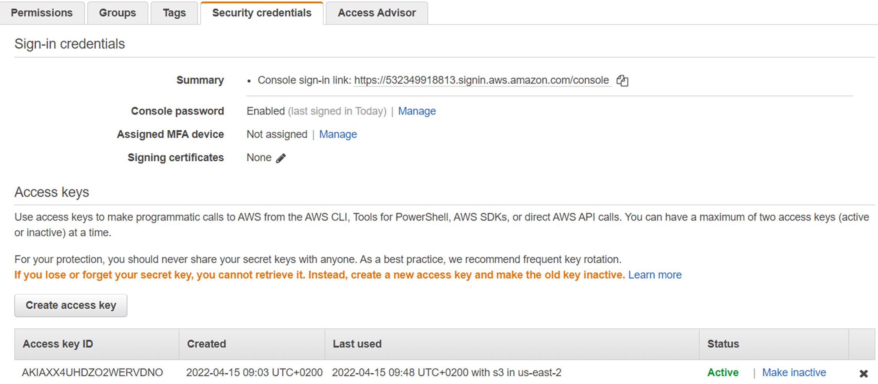
1) IAM (Identity Access Management)
Root user master to IAM users
Provides access control across all of AWS
Specifiy who can access which services and resources, and under which conditions
Access key ID & secret access key
Access to Sagemaker & S3 bucket

Slide 11
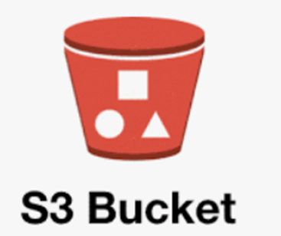
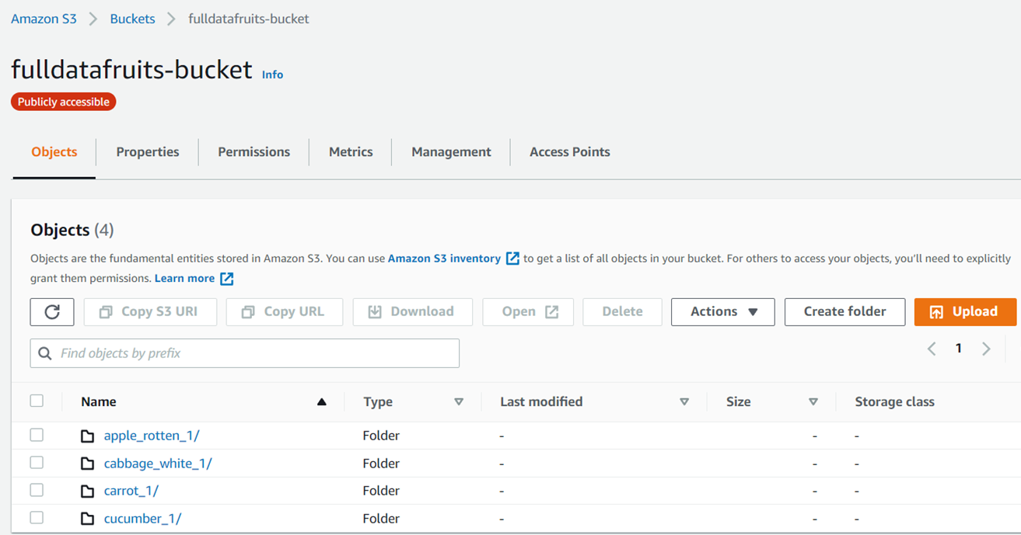
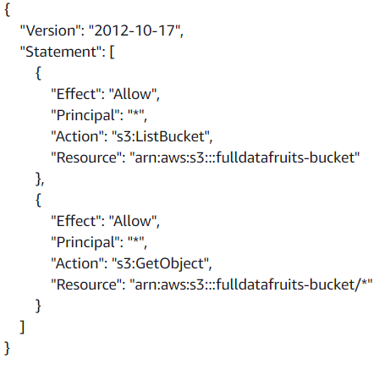
2) AWS S3 Bucket Input
Input S3 bucket « fulldatafruits-bucket »
Images loaded from a local directory
Provides object storage through a web service interface.
Json policy creation
Permission to IAM user

Slide 12
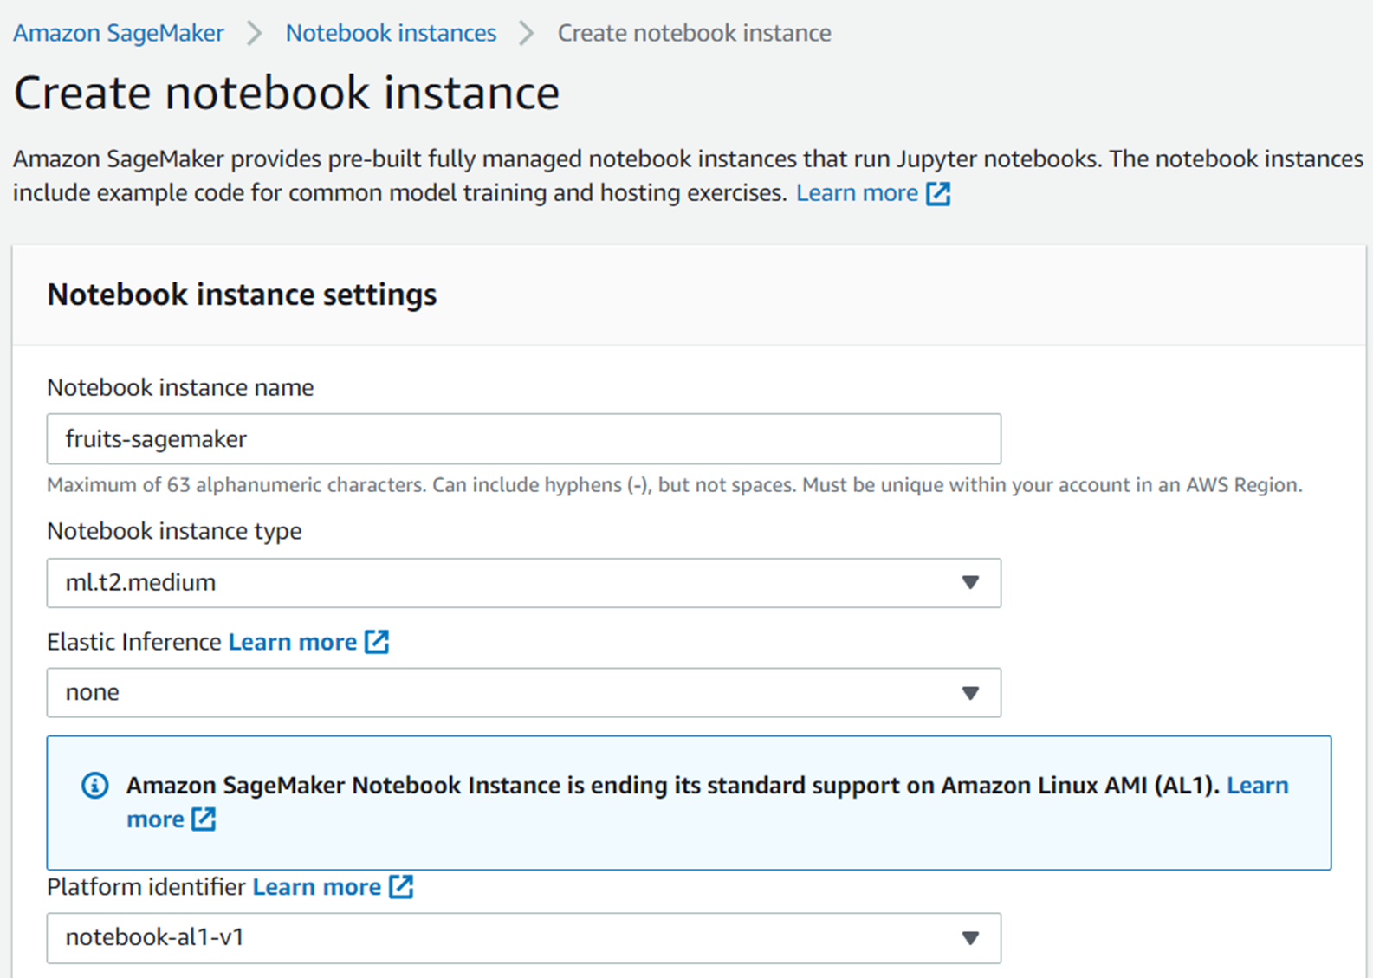
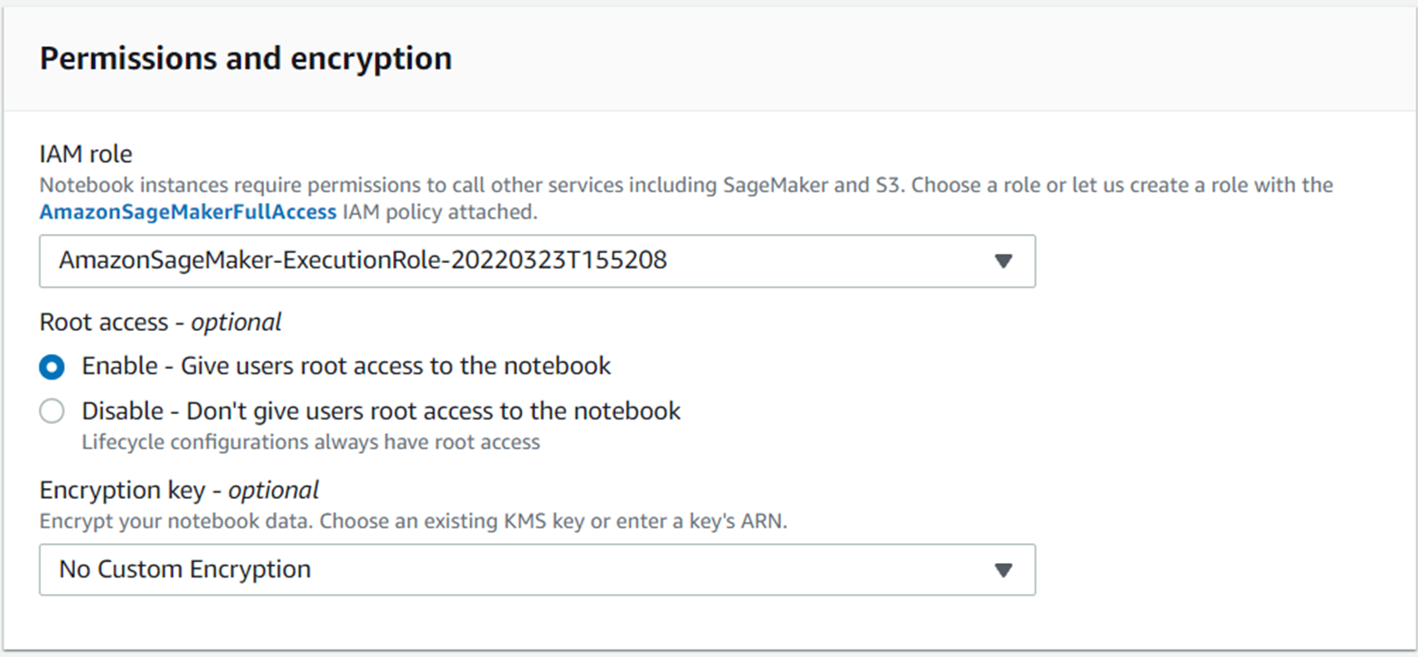
3) Sagemaker Notebook Instance
Jupyter Notebook instance creation in SageMaker – Instance Type: ml.t2.medium
Access from SageMaker to S3 – IAM strategy

Slide 13



Processing chain
CNN
VGG16
Features extraction
Spark Session
Spark context
Data loading S3 bucket
PCA
Preprocessing
Image 224 x 224
Image to Array
Grayscale
Noise reduction
Brightness

Slide 14
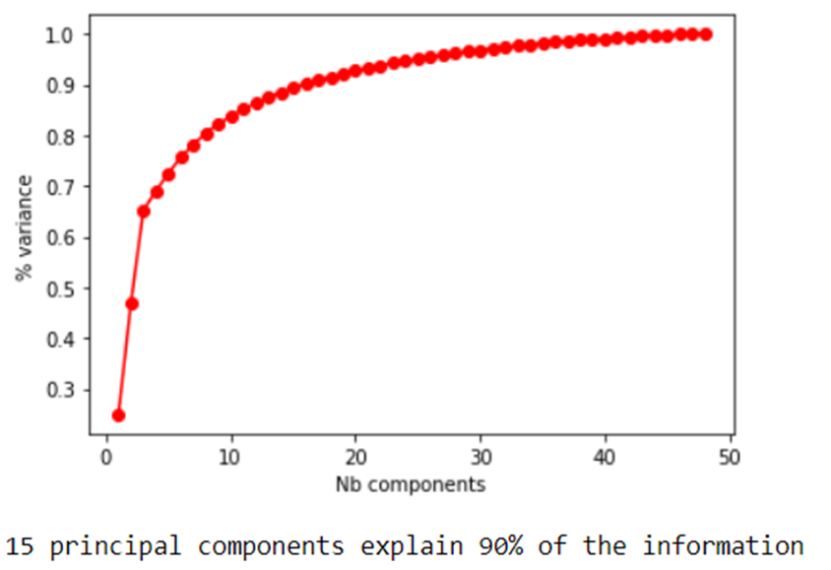
DIMENSIONALITY REDUCTION
PCA dimension reduction on our 48 images sample
Scree plot to determine optimal number of components explaining 90% variance

Slide 15
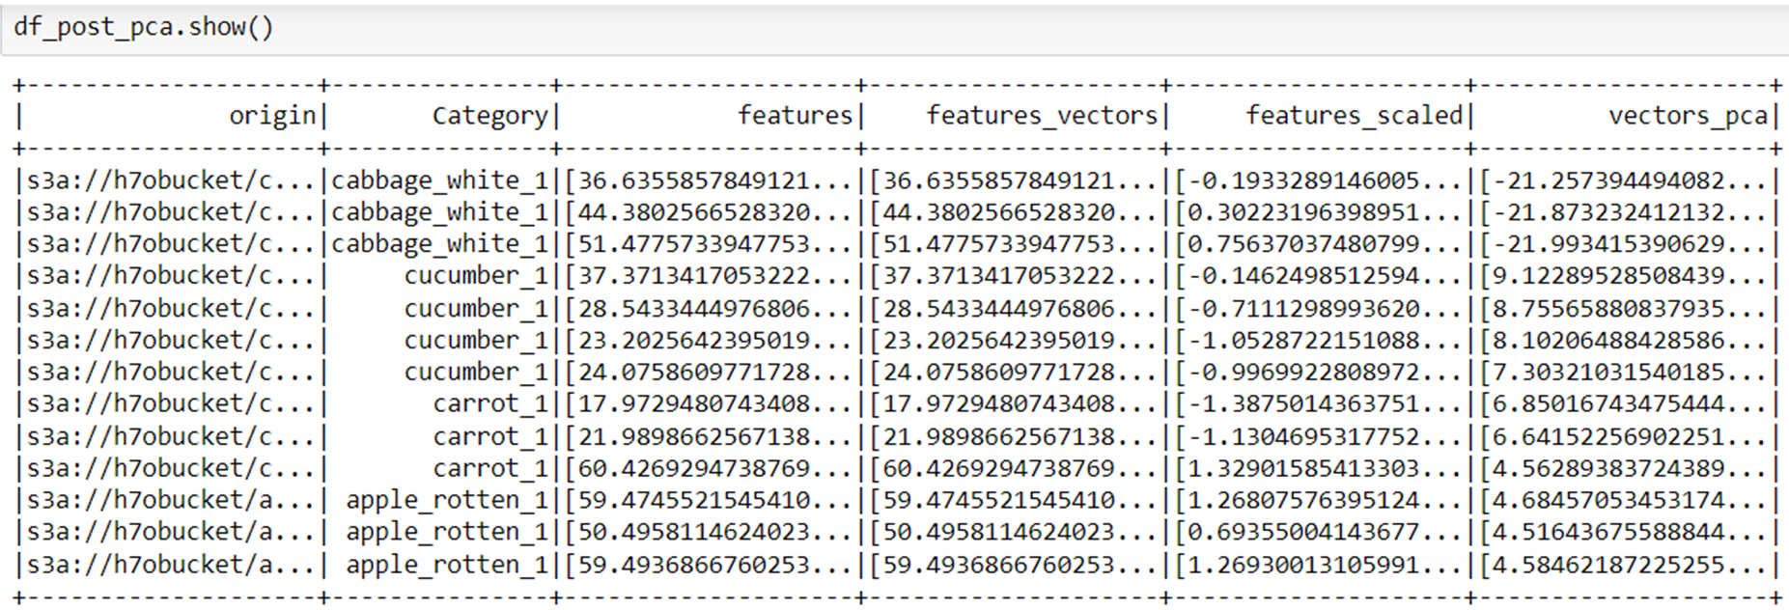
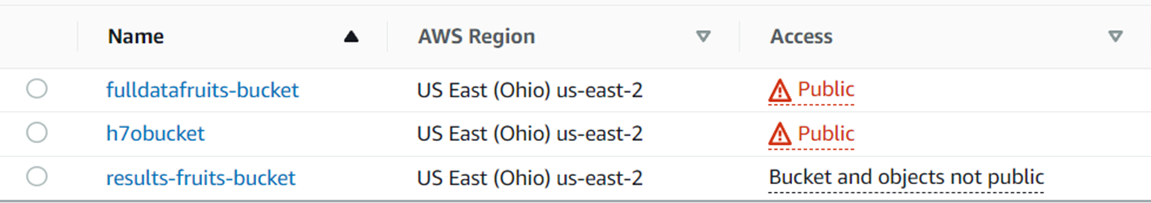

AWS S3 Bucket Output
New output S3 bucket creation « results-fruits-bucket »
Spark dataframe to pandas dataframe conversion
Saving results to « post_pca_bigset_results.csv »
Input S3 bucket
Ouput S3 bucket
Upscaling = .parquet recommended

Slide 16
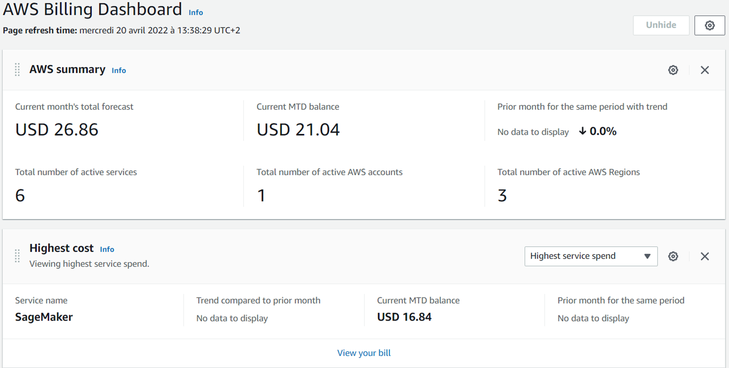
Conclusions
Set up a Big Data environment with Amazon Web Services
Sagemaker notebook instance creation
IAM permissions & access granted to IAM users
S3 input & output buckets
Images preprocessing
Resize images
Features extraction through CNN
PCA Dimensionality reduction
Going Further
More advanced preprocessing
CNN benchmarking (efficiency, speed…)
Anticipate upscaling
Cost management
Instance choice review

